Slide 1
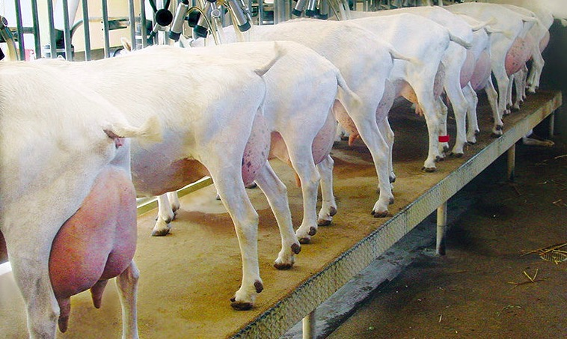
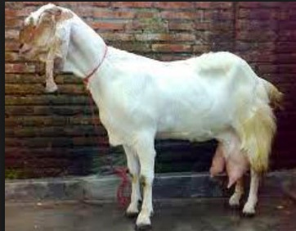
Feed Formulation and Feeding Management of Dairy Goat
Dr. Idat Galih Permana
Bogor Agricultural University
email: permana@apps.ipb.ac.id
The 2nd Summer Course on Exotic Animal in Tropic – Bogor, 23-30 July 2018

Slide 2
Dairy Goats vs Dairy Cows
Dairy goats are about 1/6 the size of a cow. This makes them easier to handle.
Dairy goats have longer productive life than the cow, about 8-10 years, compared to 4-6 years for the cow.
Dairy goat need less investment than for dairy cow.
Dairy goats are slightly more efficient than cows; it takes less feed for a dairy goat to produce a litre of milk than cow.
The price of goat milk is 4-6 time higher than dairy cow milk.

Slide 3
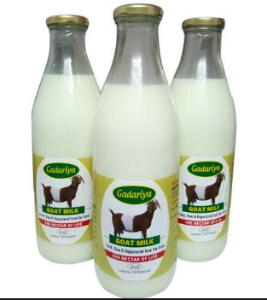
Dairy Cattle Milk vs Goat Milk
Goat milk is used for drinking, cooking and baking. It is used to make cheese, butter, ice cream, yogurt and other products
Lactose content is lower. Goat milk is suitable for lactose intolerances.
Goat milk cheese contain less cholesterol than cow milk cheese
Goat milk is more easily digested than cows milk, it’s molecules are smaller and more easily absorbed into the digestive system
Composition of Cow Milk and Goat Milk
Milk Composition (%) | Cow | Goat
Protein | 3.2 | 3.1
Fat | 3.9 | 3.5
Carbohydrates | 4.8 | 4.4
Sugars (lactose) | 4.8 | 4.4
Cholesterol* (mg) | 30.5 | 17.5
* Goat milk cheese

Slide 4
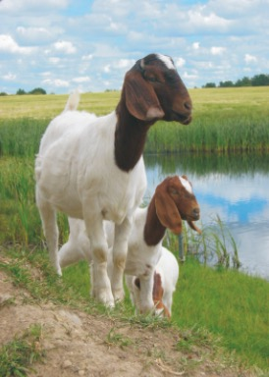
Type of Goats
Dairy Goat:
Peranakan Etawa (PE) Goat
Saanen Goat
Meat Goat:
Kacang Goat
Boer Goat
Other local goats

Slide 5
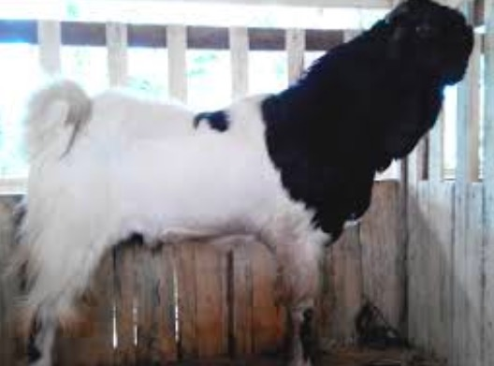
Peranakan Etawa (PE) Goat
Crossing between Jamnapari with local goat
Color patterns vary between black, white, yellowish brown or combination of both.
Goats have a large body:
Female : height 70-90 cm, body weight 45-80 kg
Males : height 90-110 cm, body weight 65-120 kg
Upright head, curved profile line.
Ears long 10-28 cm and folded at wide ends hanging
Female goats have milk production

Slide 6
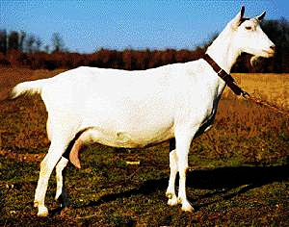
Saanen Goat
Originated in Switzerland
Saat goat is medium to large size
Rugged bone and plenty of vigor
White or light cream in color, although white is preferred
Sensitive to excessive sunlight
Performs best in cooler conditions; shade is essential

Slide 7
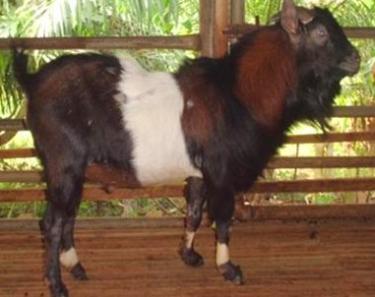
Kacang Goat
Indonesian local goat
The color of white, black, brown and short feathers
Horns are bent upward to the back
Male goats have beard, while in females are rarely found.
Short neck and back arch.
The height of the male goat body is 60-65 cm and the female is 56 cm.
The weight of adult male goats 25 kg and female 20 kg.

Slide 8
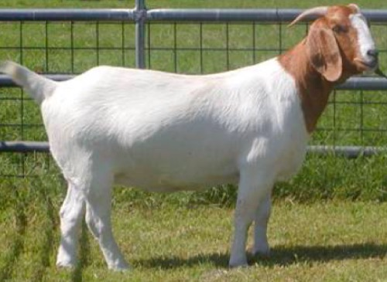
Boer Goat
Goats are from Australia
White fur color with a combination of chocolate
The average body weight of males 80 -130 kg and females 50-75 kg
Percentage of carcass 50-55%
Birth Weight 3 - 4 kg
Average Body Weight 150 - 250 g
Have a good grazing behavior

Slide 9
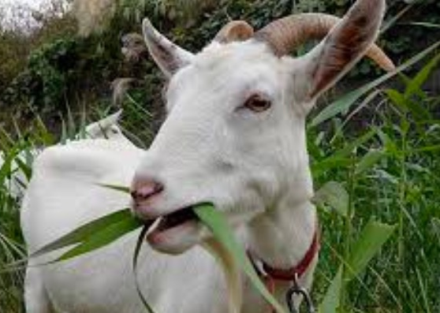
Eating Characteristic
Goats are browsers and cows are grazers
Goats select and feed with lips while cows use their tongue to grab forage
On pasture, goats will eat from the top down, including seed heads, while cows and sheep will graze close to the ground.

Slide 10
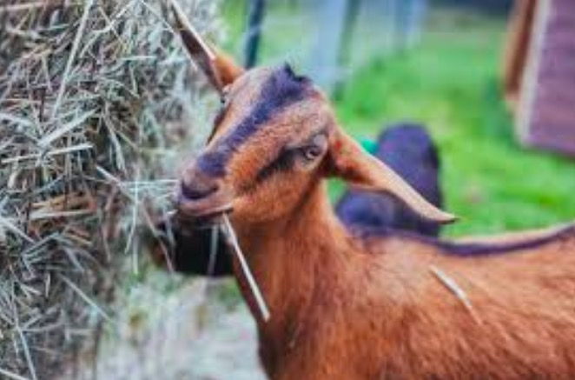
Intake Characteristics
Goats need the maintenance energy 1.5 times higher than cow, but they can eat up to twice as much as a cow.
Goats can eat 3.5-5% of body weight in dry matter, while cows are about 3.0%.
Goats will eat less feed when the quality of feed is low.

Slide 11
Nutrient Requirement of Goats
Energy
Protein
Mineral
Vitamin
Water

Slide 12
Energy
Energy is the most limiting nutrient to dairy goats.
Sources of energy:
grass, cereal grains such as corn, oats, wheat and barley and bypass fats.
Energy limitations caused by:
Inadequate feed intake, too much low quality feed, incorrect roughage to concentrate ratios.
Insufficient energy cause:
weight loss, infertility and reduced production

Slide 13
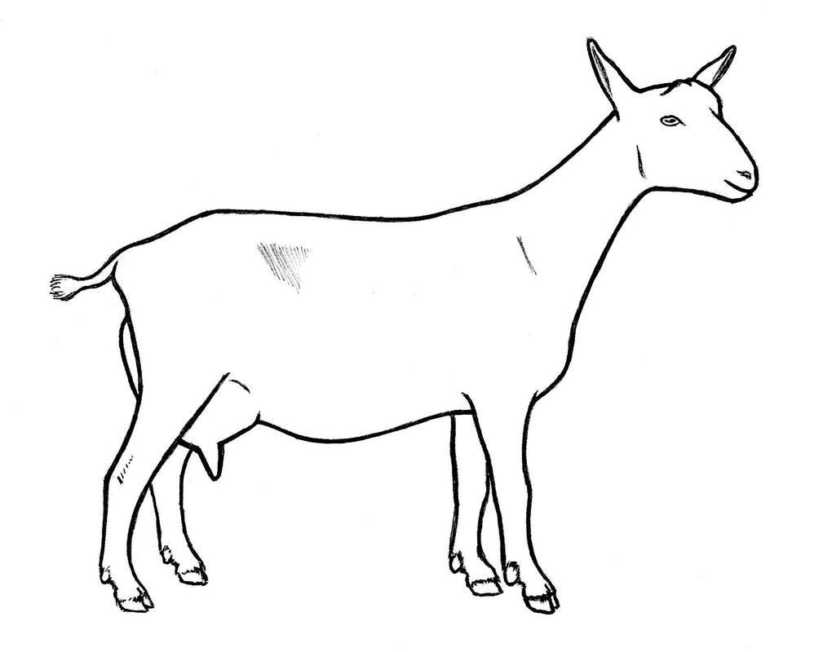
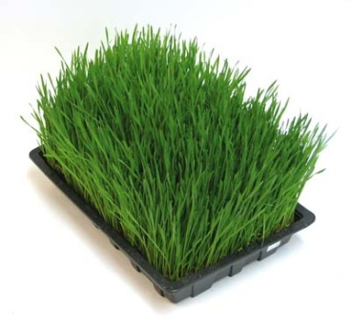
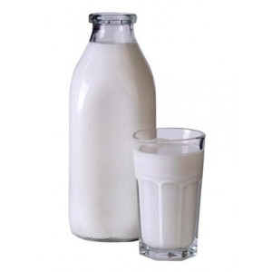
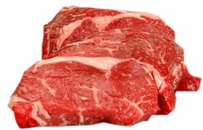
Energy Utilization in Dairy Goat
Heat Increment
CO₂
CH₄
H₂
Maintenance Energy
Feces
Feed Energy
Urine
Meat
Milk

Slide 14
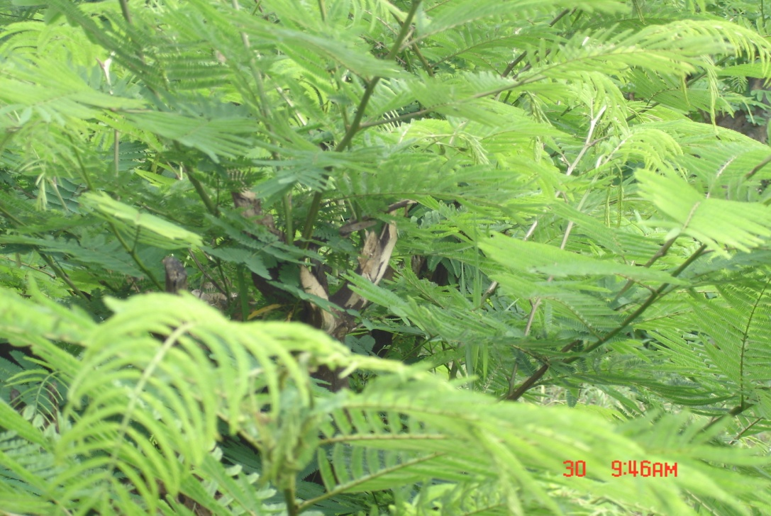
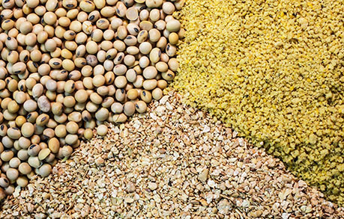
Protein
Protein is made up of amino acids. Amino acids are vital to all body processes.
Source of protein are:
Legume, soybean meal, palm kernel meal, coconut meal, corn gluten meal, tofu waste, etc.

Slide 15
Mineral
Minerals are essential to body functions of an animal. Macro minerals are the minerals most nutritionists balance for in a ration because they are usually deficient without supplementation.
Macro Minerals:
Calcium (Ca), Phosphorus (P), Magnesium (Mg), Sodium (Na) and Chloride (Cl).
Micro Minerals:
Copper (Cu), zinc (Zn), cobalt (Co), iodine (I), selenium (Se), iron (Fe) and manganese (Mn).

Slide 16
Vitamins
Vitamins can be divided into two major groups:
Fat Soluble Vitamins and Water Soluble Vitamins.
The fat soluble vitamins are stored in the fat or lipid portion of feed and include vitamins A, D, E and K.
The water soluble vitamins (Vit B) are usually met by feedstuffs, rumen synthesis and tissue synthesis.

Slide 17
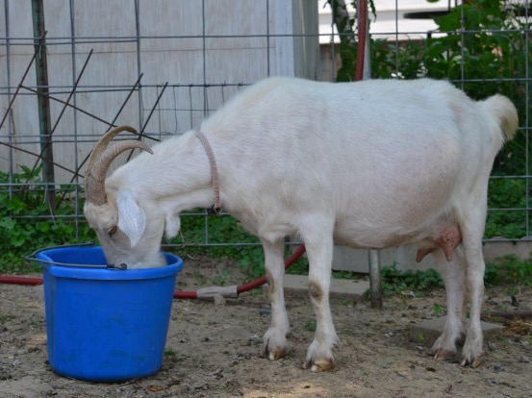
Water
Water is the important nutrient. Access to clean water is very important in dairy goat production
The function of water:
digestion, nutrient absorption, excretion of waste products, control of body temperature, growth of young animals and milk production.
Water requirement depend on:
Physiological status
Environment temperature
Kind of feed
Water requirement is 1.5 – 2.5 liter/day

Slide 18
Nutrient Requirement for Dairy Goats
Maintenance Requirement:
Basic living requirement for basic activities (breathing, blood circulation, maintaining body temperature) with no change in body weight
Production Requirement:
Growth
Reproduction
Pregnancy
Milk Production
Milk Quality

Slide 19
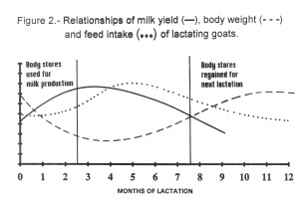
Lactation Curve of Goats
One lactation period is 305 days
Peak lactation generally occurs between week 6 and 9 after kidding.
Feed intake does not peak until week 12 to 16 postpartum (negative energy balance)

Slide 20
Lactation Periods of Goat
Early Lactation
Peak
Mid to Late Lactation
Dry Period

Slide 21
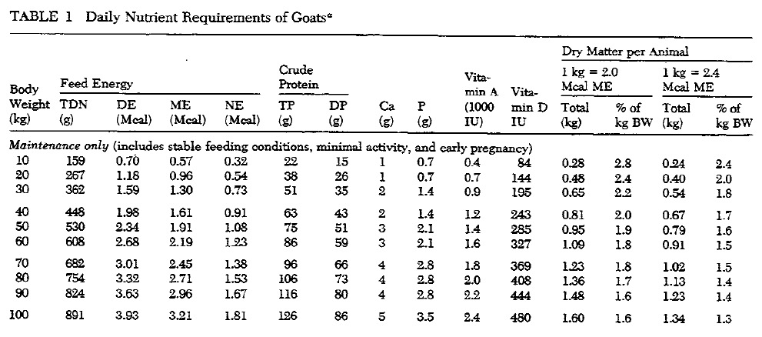
Nutrient Requirement of Goats (NRC, 1981)

Slide 22
Nutrient Requirement of Goats
Period | DM intake (%BW) | Crude Protein | TDN | Calcium | Posphor
Maintenance (low activity) | 1.3 - 2.8 | 9.3 | 67 | 0.37 - 0.41 | 0.26 - 0.29
Maintenance (early gestation) | 2.5 - 5.0 | 9.2 | 66 | 0.32 - 0.47 | 0.24 - 0.33
Growing (50-150 g/day) | 2.5 – 5.0 | 9.2 - 12 | 68 | 0.44 – 0.60 | 0.23 – 0.47
Late gestation | 2.5 - 5.0 | 13.8 | 68 | 0.34 | 0.24
Lactation | 3.0 - 5.0 | 14 - 18 | 65 - 70 | 0.45 - 0.60 | 0.35 - 0.50

Slide 23
Type of Feed Ingredient for Goat
Roughage
Concentrate
Feed Supplement
Additive

Slide 24
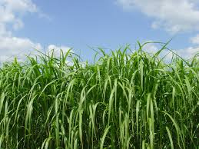
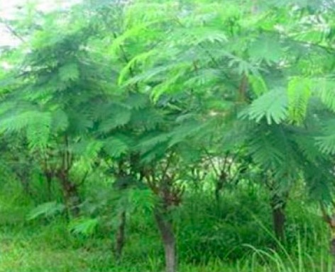
1. Roughage
In ruminant, the roughage is as energy source
Kind of roughage
Grass (native grass, napier grass, king grass, benggala grass, etc)
Legume (leucaena, gliricidia, caliandra, sesbania, indigofera, etc)
Agricultural Wastes (rice straw, corn stover, sweet potato leaf, cassava leaf, etc)

Slide 25
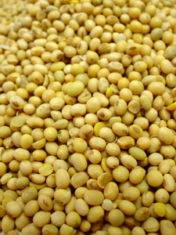
2. Concentrate
Concentrate as energy or/and protein sources
The quality of concentrate depend on:
Processing
Palatability
Nutrient composition
Contamination
Storage

Slide 26
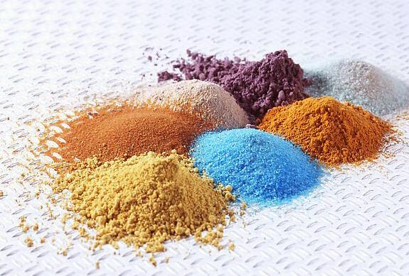
3. Feed Supplement
A feed used with another to improve the nutritive balance or performance
Supplement is needed a small amount to enrich
A source of micro-nutrients (minerals and vitamins)
Usually given in the form of Premix

Slide 27
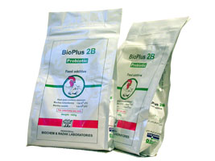
4. Additive
An ingredient or combination of ingredients added to the basic feed mix or parts thereof to fulfil a specific need.
Usually used in micro quantities and requires careful handling and mixing
Additive is not a natural feed (antibiotics, probiotics, hormones, enzymes, anti-fungal, etc.)

Slide 28
Feed Ingredient for Goat
Roughage
Concentrate
Feed Supplement
Additive

Slide 29
Corn
Corn as energy source
Water content of 12-14 %
Nutrient content:
Crude Protein 7-8%
Low Crude Fiber
TDN 80-82%
The quality of local corn varies depend on post-harvest handling and storage

Slide 30
Rice Bran
Rice bran is rice mill waste
As energy source for ruminant
Water content of 10-14%
The quality varies
Water 10-14%
Crude Protein 10-12%
TDN 65%
EM 2700-2900 kcal/kg
Used in ruminant 40% and in poultry 10-20%
Problems:
High CF, easy to rancidity, high pytate acid and often mixed husks or limestone

Slide 31
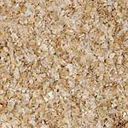
Wheat Pollard
Pollard is byproduct of milling wheat
Used as energy source for ruminant
The quality of pollard is relative stable:
Water content 10-12 %
Crude Protein 14%
TDN 68%
ME 2100-2200 kcal kg
Constraints Crude Fiber 13 %

Slide 32
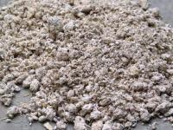
Cassava Waste
Cassava waste is byproduct from tapioca industry
Used as energy sources
Nutrition content:
Low Crude Protein 1.8-2%
High energy TDN 78.9%
Contains HCN (but lower than cassava)
In ruminant rations used up to 40%

Slide 33
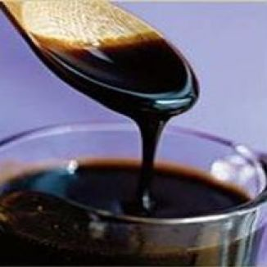
Molasses
Molasses is a byproduct from sugar mill
Has high palatability, both for ruminants and poultry.
High carbohydrate content (48-60% in the form of sugar).
Have a good mineral content.
An important ingredient for the manufacture of mineral blocks.
Its use in ruminant ration 15%

Slide 34
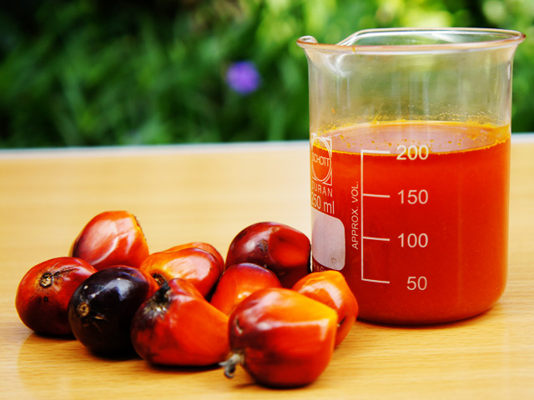
Crude Palm Oil (CPO)
CPO is main products of palm oil industry
As energy sources
Nutrient content:
Water content of 1-2 %
EM 7800-8000 kcal/kg
In Poultry used up to 5 %
Improving the palatability of the ration
Low heat increment

Slide 35
Soybean Meal (SBM)
SBM is a byproduct from processing soybean oil
As protein sources, has complete amino acids
Nutrient content:
Water content of 10-11%
Crude protein 49-52%
TDN
EM 2800-2900 kcal/kg
Limitation: trypsin inhibitor

Slide 36
Palm Kernel Meal (PKM)
PKM or PKC is byproduct from palm oil industry
The composition of nutrients vary depending on the processing
Crude Protein 13-17%
TDN 68-75%
EM 1600 kcal/kg
Fat and fiber varies.
Methionine deficiency
Used in ruminant max 25%

Slide 37
Corn Gluten Meal (CGM)
CGM is a waste oil processing corn
Used as protein sources
Nutrient contents:
Water content 9-10%
Crude Protein 65%
ME 3900-4000 kcal/kg
Usage on poultry feed up to 8%
CGM Import USA

Slide 38
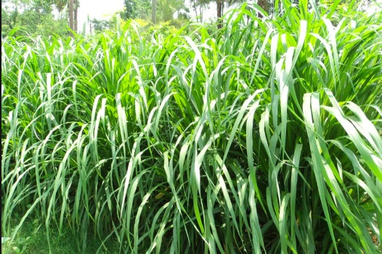
Elephant Grass - Napier Grass
Origin from Africa middle area
Productivity is high (150 ton/ha/year)
Nutrient content:
DM 12-18%
CP 6-9%
CF 26-40%
TDN 55-67%
Palatability is quite good

Slide 39
Leucana leucocephala
Origin from Guatemala.
Nutrient content:
CP : 14-19%.
CF : 33-66%.
Vit content C and A are usually high.
Contains anti nutrition mimosin, dangerous especially for monogastrik.
Used up to 25% in goat ration

Slide 40
Caliandra calothyrsus
Origin from Central America
Nutrient content:
Crude Protein quite high 24%.
Crude Fiber relatively low 24%
Generally does not contain toxins.
The content of tannin is quite high 11%.
This tannin causes low digestibility

Slide 41
Sebania sesban
Origin from Southeast Asia.
Palatability is very good.
Nutrient content:
Crude Protein is quite high around 29%.
Crude Fiber is quite low 5-18%.
Containing saponins and tannins
Digestibility is quite high 65-73%.

Slide 42
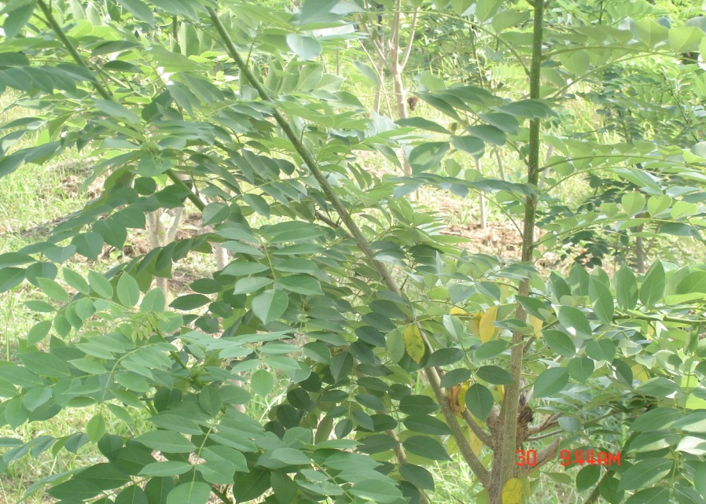
Gliciridia sepium ( Jacq.)
The origin from Central America.
Nutritional quality varies:
Crude Protein is about 19%
Palatabily relatively low
Contains Flavanoid anti nutrition 1-3.5% and 3-5% phenol IN dry matter.
Digestibility is from 55-70%

Slide 43
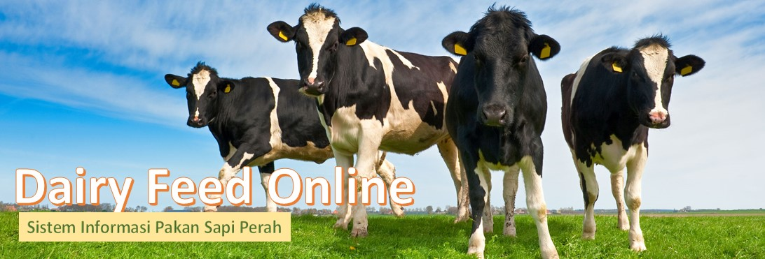
Goat Ration Formulation using Dairy Feed Online
Dr. Idat Galih Permana
Bogor Agricultural University
email: permana@apps.ipb.ac.id

Slide 44
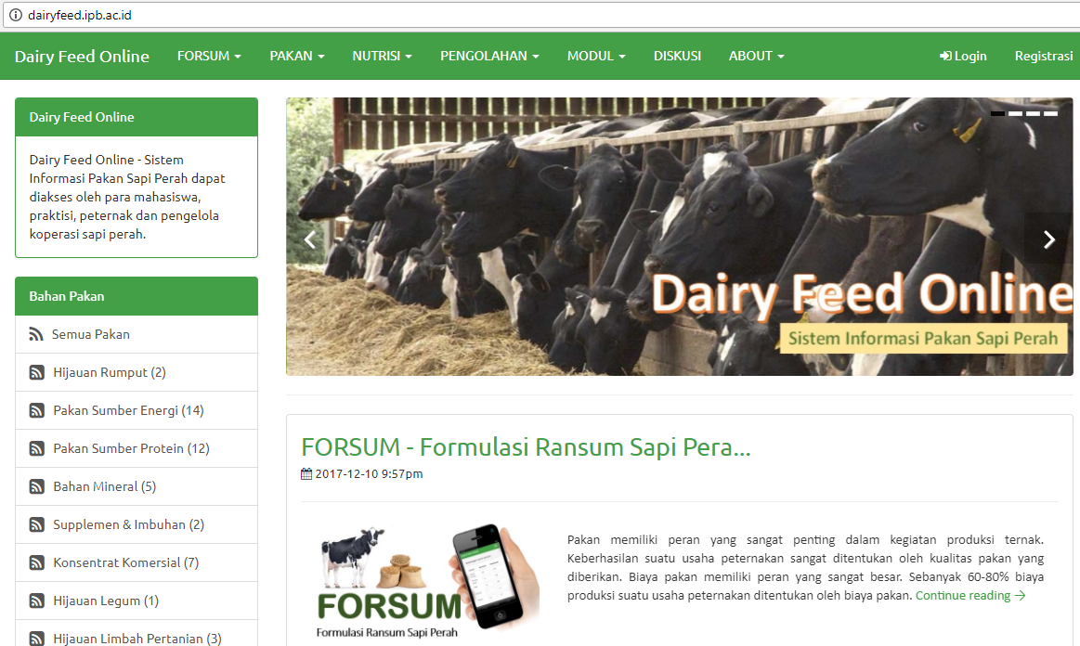
Dairy Feed Online http//dairyfeed.ipb.ac.id

Slide 45
What is FORSUM Online ?
FORSUM Online is an web based application for ration formulation for dairy cattle of ruminant using local feed ingredients
FORSUM calculate the ration using Linear Programing
Least cost ration

Slide 46
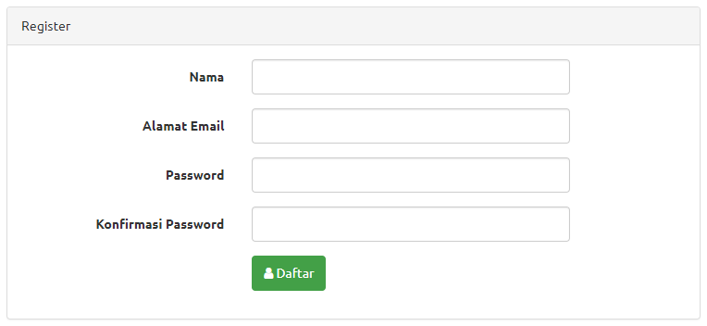
How is to registration ?
Click Registration
Entry user name
Entry email address
Entry Password
Re-entry Password

Slide 47
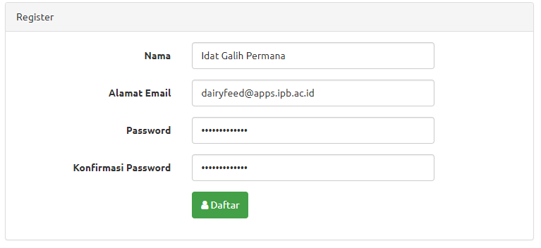
How is to registration ?
Example registration form:

Slide 48
Step by Step for Feed Formulation
Choose Type of Rations
Entry the Nutrient Requirement
Choose Feed Ingredient for the Ration
Calculate the Formula
The Result

Slide 49
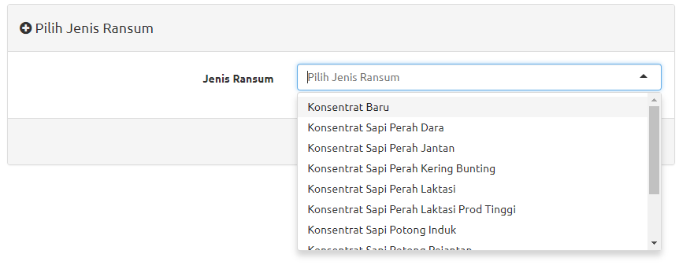
1. Type of Rations
Choose Menu FORSUM and Sub Menu FORMULASI RANSUM
Choose type of Ration:
Concentrate of dairy cattle (Konsentrat Sapi Laktasi)
Concentrate of heifer (Konsentrat Sapi Dara)
Concentrate of Bull (Konsentrat Sapi Jantan)
Etc

Slide 50
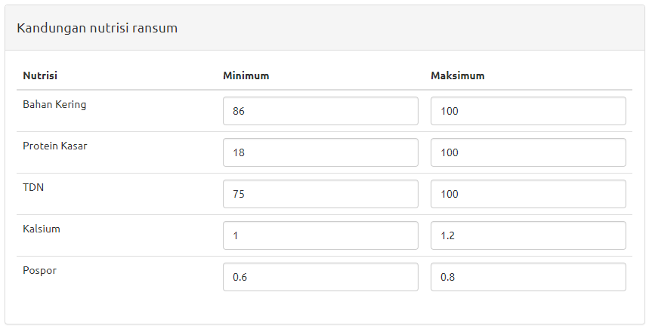
2. Entry the Nutrient Requirement
Entry the nutrient requirement/restriction of MINIMUM and MAXIMUM for each nutrient or use nutrient standard.

Slide 51
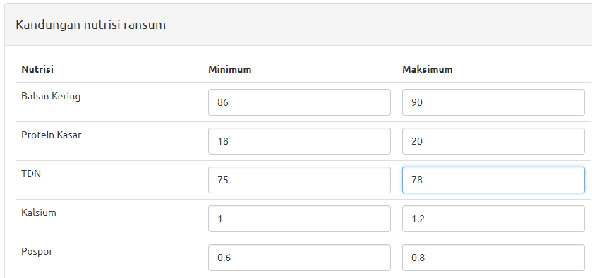
Nutrient restrictions

Slide 52
3. Choose Feed Ingredient for the Ration
Click “Pilih Bahan Pakan” (Choose Ingredients), then choose:
Native grass (Rumput Lapang)
Naper grass (Rumput Gajah)
Corn (Jagung), …. etc
Click “Tambah Pakan” (Add Ingedient), for Add other feed ingredients
Click ”Hapus” (Delete) for delete a feed ingredient
Delete Feed Ingredient
Choose Feed Ingredient

Slide 53
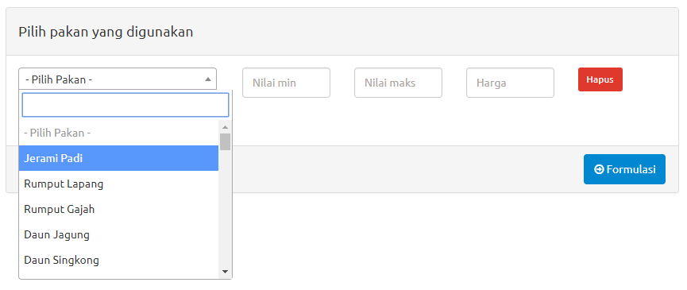
Choose Feed Ingredients
Choose Feed Ingredient

Slide 54
Example: List of Feed Ingredients
Bahan Pakan | Min | Max | Harga (Rp/kg)
Jagung | 10 | 40 | 3,000
Bungkil Kedelai | - | 30 | 6,500
Bungkil Kelapa | - | 30 | 2.750
Bungkil Sawit | - | 20 | 1,400
Dedak Padi Halus | - | 30 | 1,800
Onggok | - | 30 | 2,200
Kapur | - | 2 | 500
Dicalsium Phospat | - | 1.5 | 20,000

Slide 55
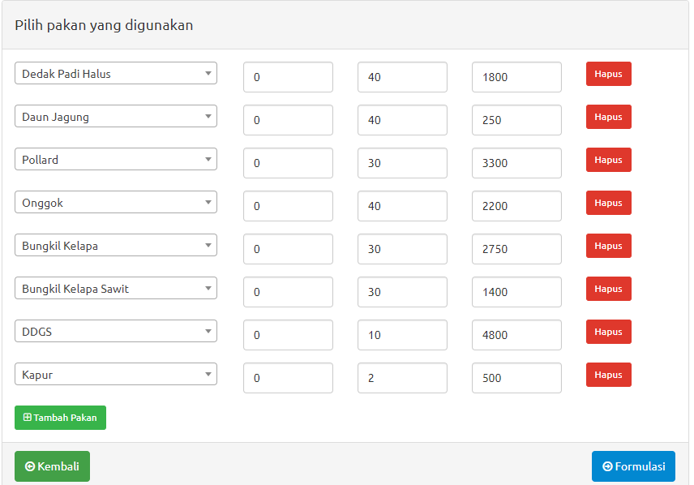
4. Calculate the Formula
When all the feed ingredients are choose, than click “FORMULASI” (Formulation) to calculate.
FORMULATION

Slide 56
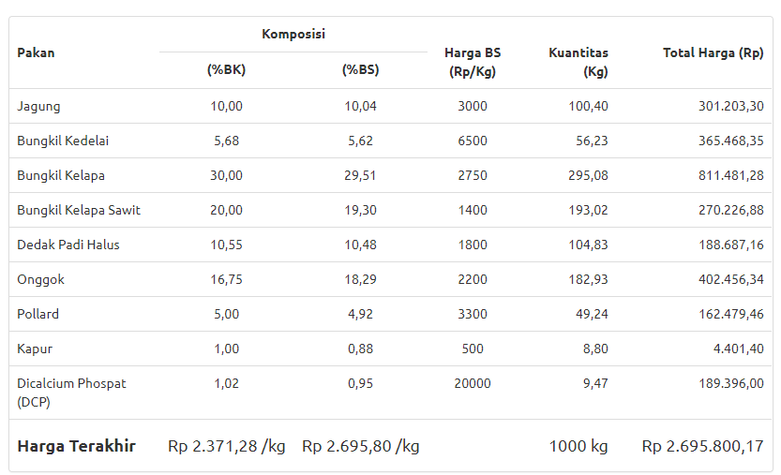
5. Result of Ration
Ration Composition

Slide 57
Ration Composition
In Dry Matter Composition
In As Feed Composition

Slide 58
Ration Composition
Price per kg DM
Price per kg As Feed
Kg ration totsl
Ration Cost

Slide 59
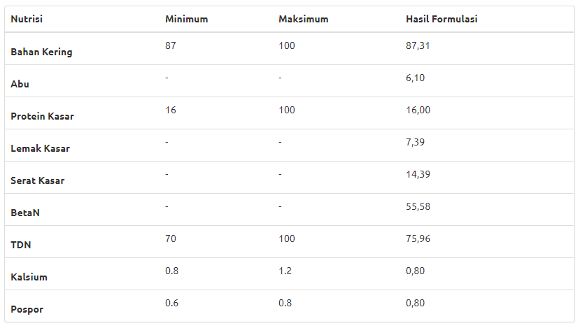
Nutrient Composition of the Ration
In Dry Matter (DM) Composition

Slide 60
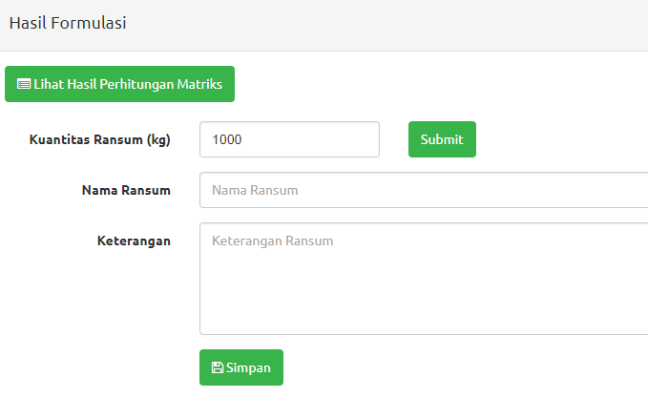
6. Save the File
Click SIMPAN to save the file of ration
Entry the quantity of ration (kg), Name of Ration and Notes
Then Click SUBMIT
Quantity of Ration
Quantity, Name of Ration and NotesRansum
Save File

Slide 61
Formulation 1. Ration for Lactation Goat
Feed Ingredients:
Elephant Grass, Leucaena
Corn, Rice Bran, Cassava Waste
Soybean Meal, Coconut Meal, Palm Kernel Meal
Mollases
Salt, Limestone
Nutrient Requirement:
TDN 68%
CP 15%
Ca 0.4%
P 0.35%

Slide 62
Formulation 2. Concentrate for Lactation Goat
Feed Ingredients:
Corn, Rice Bran, Cassava Waste
Soybean Mean, Coconut Meal, Palm Kernel Meal
Molasses
Salt, Limestone
Nutrient Requirement:
TDN 77%
CP 18%
Ca 0.7%
P 0.5%

Slide 63
The Results

Slide 64
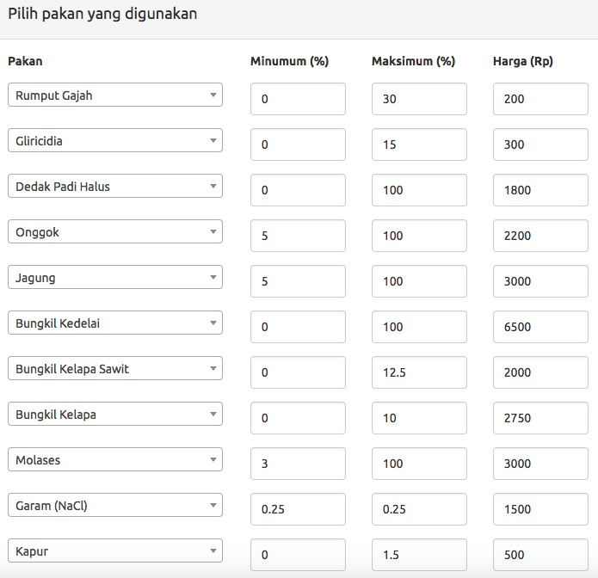
Ingredient List of Milk Goat Ration

Slide 65
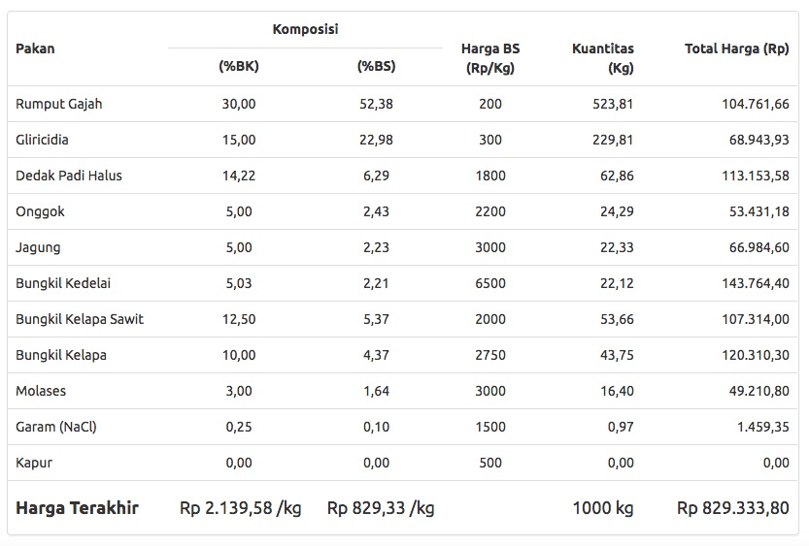
Feed Composition of Milk Goat Ration

Slide 66
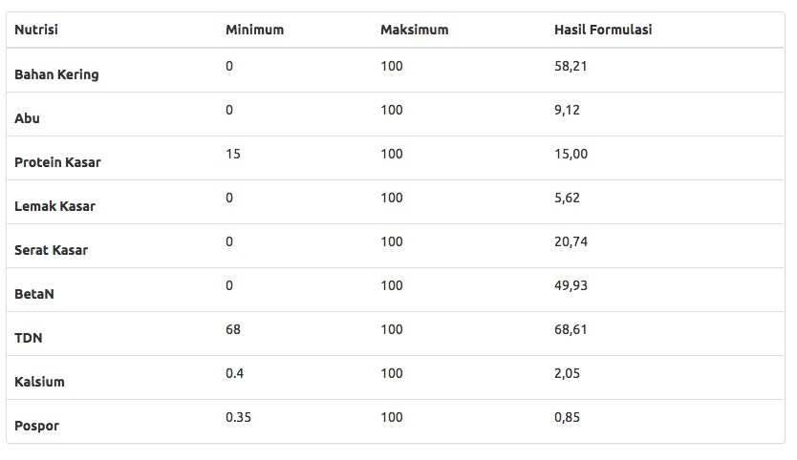
Nutrition Composition of Milk Goat Ration

Slide 67
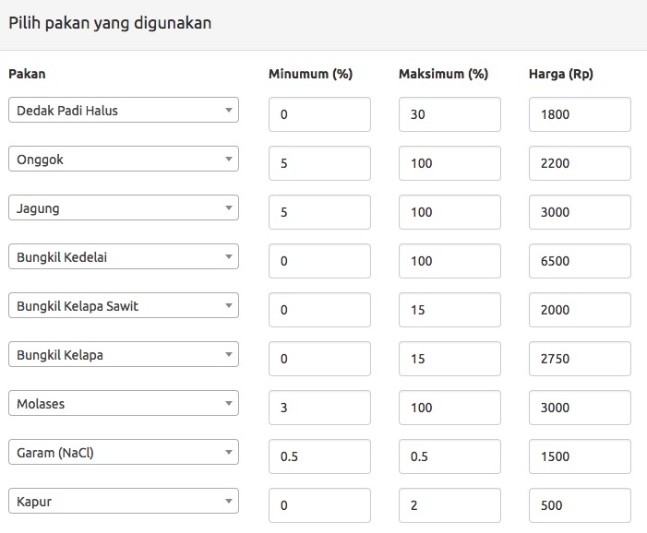
Ingredient List of Milk Goat Concentrate

Slide 68
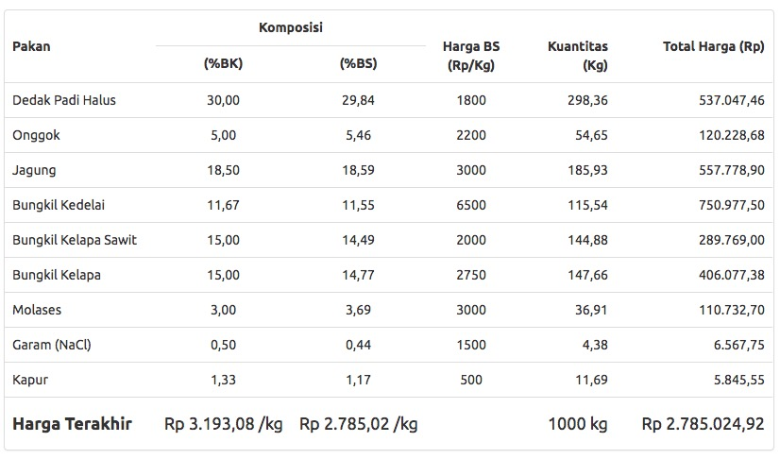
Feed Composition of Milk Goat Concentrate

Slide 69
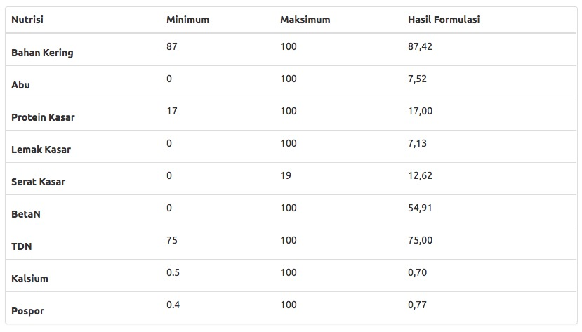
Nutrition Composition of Milk Goat Concentrate

Slide 70
Thank you
Dairy Feed Online – http://dairyfeed.ipb.ac.id
Dairy Expert:
Dr. Ir. Idat Galih Permana, MSc.Agr.
Email: permana@apps.ipb.ac.id
HP. 081 380 263 993

